Slide 1

NETFLIX VISUALISATION
indepth Learning for finding the trends across

Slide 2

TABLE OF CONTENTS
Project Overview
Data view and Key Insights
Methodology
Exploratory Data Analysis
Visualization
Data Preprocessing
Feature Extraction
Model Architecture
Training and Evaluation
Results
User Interface
Challenge
Future Scope
14.Conclusion

Slide 3
PROJECT OVERVIEW
Objective:
To create a data-driven system that analyzes Netflix’s content catalog utilizing the Kaggle Netflix Movies and TV Shows dataset. The project's goal is to identify trends in Netflix’s expansion strategy, the balance between original and licensed content, genre popularity, and preferences across global markets using solely this dataset.
Outcomes:
• Performed data preprocessing and feature engineering on real-world data • Conducted Exploratory Data Analysis (EDA) to discover key insights • Applied machine learning models for classification • Built an interactive dashboard for visualization and insights

Slide 4
DATASET OVERVIEW AND KEY INSIGHTS
Dataset Details :
Total Rows: 8807
Total Clumns: 12
Data Types: Text (string) and numbers (integer)
REASON OF CHOOSING THEDATASET :
Helps us learn how to clean and prepare real-world data
Useful for performing data analysis (EDA)
Improves understanding of data visualization
Helps apply machine learning techniques like clustering

Slide 5
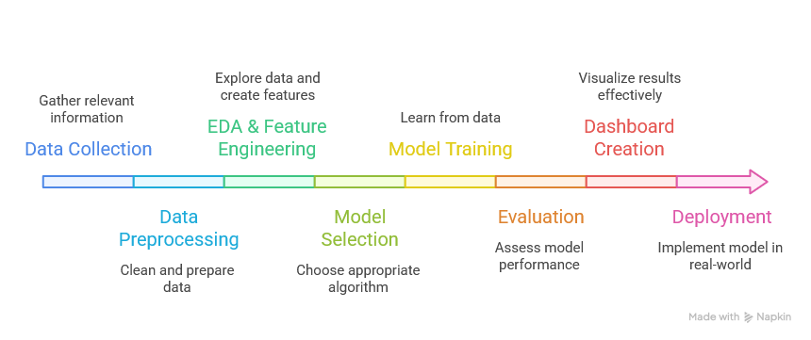
METHODOLOGY
Exploratory Data Analysis (EDA) & Feature Engineering
Analyzed the dataset to find patterns and trends
Created new features to improve model performance
Modeling & Advanced Analytics
Applied machine learning models
Trained, tested, and tuned models for better accuracy
Dashboard & Visualization
Built charts and graphs Interactive to present insights
Developed a user-friendly dashboard
Evaluation & Deployment
Evaluated model performance using metrics
Prepared the model for real-world use

Slide 6
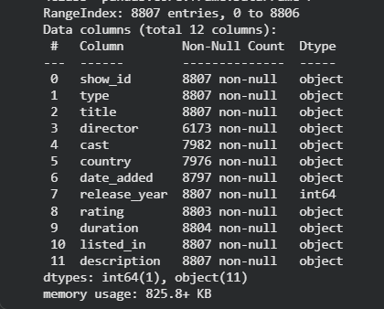
Exploratory Data Analysis
Objective of EDA
Understand dataset structure and quality
Identify patterns and relationships
Detect missing values and duplicates
Analyze distribution of languages
Exploratory Data Analysis (Overview)
Performed initial data inspection to understand dataset structure
Dataset contains Netflix titles with multiple attributes like:
Type (Movie / TV Show)
Country, Rating, Genre, Duration
Used:
.shape, .info(), .isnull(), .duplicated()

Slide 7
Exploratory Data Analysis
Data Quality Analysis
Missing values found in:
Director, Cast, Country, Rating
Duplicate rows detected and removed
Inconsistent values found in:
Rating column (e.g., "90 min", "1 Season")
Observed:
Clean structure
Balanced formatting of columns
Dataset Structure
Rows: ~8000+ entries (Netflix dataset)
Columns include:
show_id, type, title, director, cast
country, date_added, release_year
rating, duration, listed_in

Slide 8
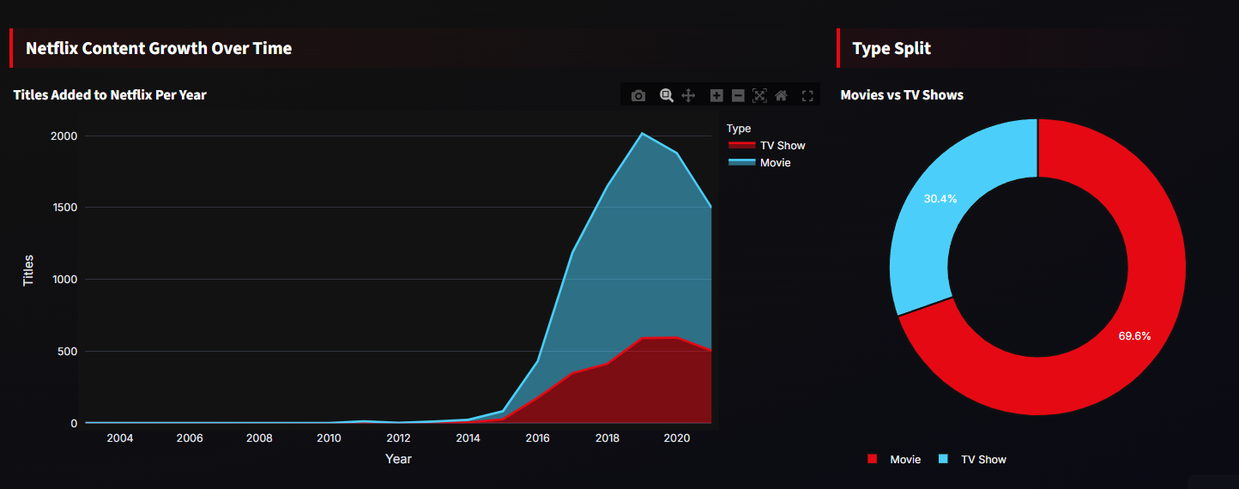
VISUALIZATION
Visualization helps us understand the dataset
better by converting numbers into meaningful
graphs.
Purpose of Visualization
Understand distribution of languages
Identify imbalance in dataset
Support insights from EDA
Used: Matplotlib , Seaborn
Clustering Visualization
K-Means clustering applied
Features used: Duration , Rating , Country
Goal : Identify trends, patterns, and distributions

Slide 9
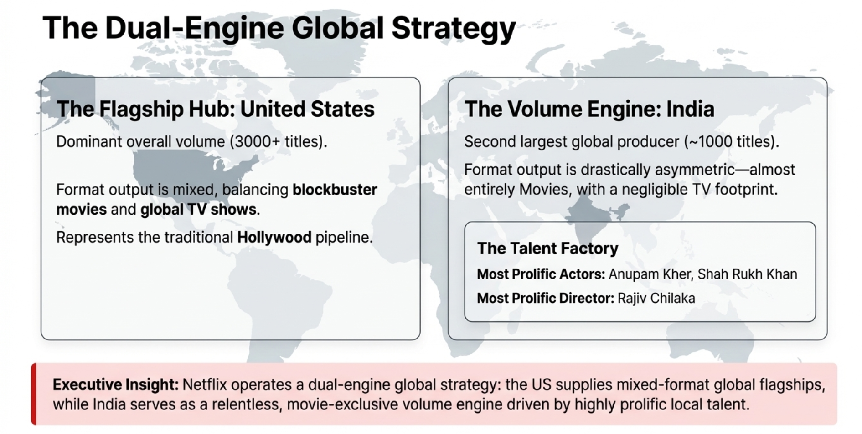

Slide 10
DATA PREPROCESSING
Data preprocessing is important because raw text data often contains noise and inconsistencies. We cleaned and standardized the data to make it suitable for machine learning.
Essential step to prepare raw text data
Improves data quality and consistency
Reduces noise and redundancy
Ensures better model performance
Duplicate entries can mislead the model by repeating the same information, so we removed them to ensure fair learning .
Identified duplicate rows
Removed identical text entries
Prevented model bias
Text Cleaning - cleaned the text using regular expressions to remove unwanted characters and make the data uniform.
Removed punctuation
Removed special character
Removed extra spaces
Applied regex cleaning

Slide 11
DATA PREPROCESSING
Text Normalization -Normalization ensures consistency.
Converted text to lowercase
Standardized formatting
Reduced variability
Text Cleaning - cleaned the text using regular expressions to remove unwanted characters and make the data uniform.
Removed punctuation
Removed special character
Removed extra spaces
Applied regex cleaning

Slide 12
FEATURE EXTRACTION
Feature extraction is the process of converting raw text into numerical data so that machine learning models can understand and process it.
Why Feature Extraction is Needed?
Since models work with numbers, we must transform text into numerical form. This step is crucial for enabling the model to learn language patterns.
Machines cannot understand raw text
Text must be converted into numbers
Helps model learn
Improves prediction accuracy
Tokenization breaks text into individual words and assigns each word a number. This is the first step in converting text into machine-readable format.

Slide 13
FEATURE EXTRACTION
Key Features Extracted
Content Type - Movie / TV Show classification
Genre Analysis - Extracted and separated multiple genres per title
Release Year - Used to analyze content trends over time
Duration - Converted into numeric format (minutes / seasons)
Country - Identified top content-producing countries
Date Added - Converted to datetime format for timeline analysis
Rating - Categorized content based on audience suitability (TV-MA, PG, etc.)
Why Feature Extraction Matters?
Enables trend analysis
Improves data visualization
Supports recommendation systems
Helps uncover hidden patterns

Slide 14
Model Architecture
Random Forest is a powerful ensemble-based classification algorithm that builds multiple decision trees during training and combines their outputs to produce a more accurate and robust prediction. Instead of relying on a single model, it uses a technique called bootstrap aggregation (bagging), where each tree is trained on a randomly selected subset of the data along with a random subset of features, promoting diversity among the trees. Each decision tree makes an independent prediction based on learned decision rules, and the final classification is determined through majority voting, which helps reduce overfitting and improves the model’s overall generalization performance.
LAYERS OF GRU:
Input Layer: Receives the input features from the dataset, which are used to train multiple decision trees on different subsets of the data.
Ensemble of Decision Trees: Instead of a single linear model, Random Forest constructs multiple decision trees using randomly sampled data (bagging) and random subsets of features, allowing each tree to learn diverse decision rules.
Splitting Mechanism: Each tree recursively splits the data based on feature values that best separate the classes, forming a hierarchical structure of decisions.
Output Layer: Each decision tree produces a class prediction, and the final output is determined by majority voting (for classification) or averaging (for regression), resulting in a more accurate and stable prediction.

Slide 15
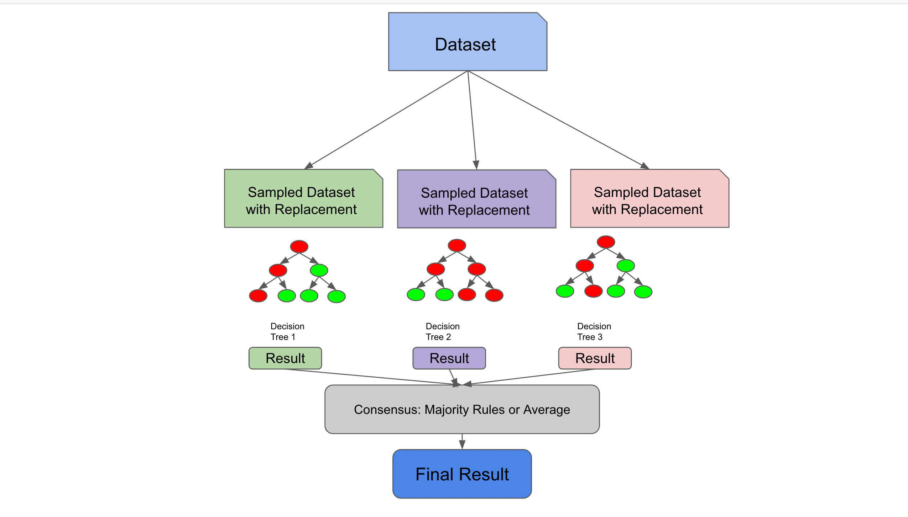
Model Architecture

Slide 16
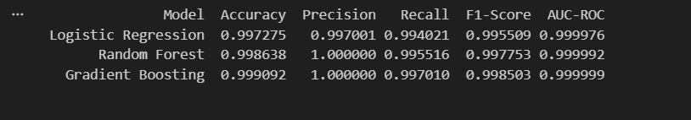
Training and Evaluation
In this analysis of classification models, a structured feature set was created from a preprocessed dataset, with a binary target variable designed to differentiate between content types. The data was split into training and testing sets, ensuring class balance to provide an unbiased model evaluation. Three machine learning models—Logistic Regression, Random Forest Classifier, and Gradient Boosting—were trained and assessed using accuracy, precision, recall, F1-score, and AUC-ROC metrics. The results indicated that all models performed exceptionally, highlighting robust patterns within the data that facilitate clear classification. Logistic Regression emerged as the preferred model due to its high performance across all metrics, coupled with lower computational demands and greater ease of interpretation compared to more complex models. This classification approach underscores the efficacy of the chosen features in accurately distinguishing between categories, leading to dependable predictions.

Slide 17
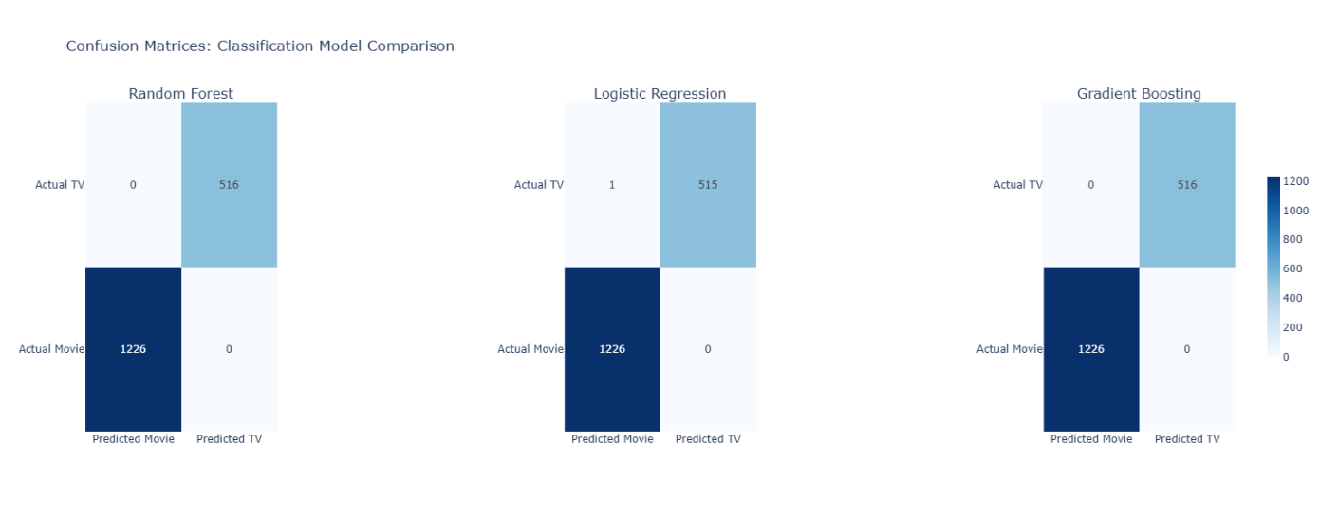
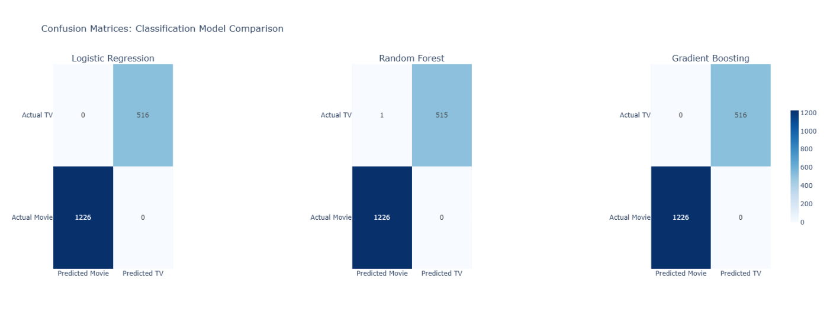
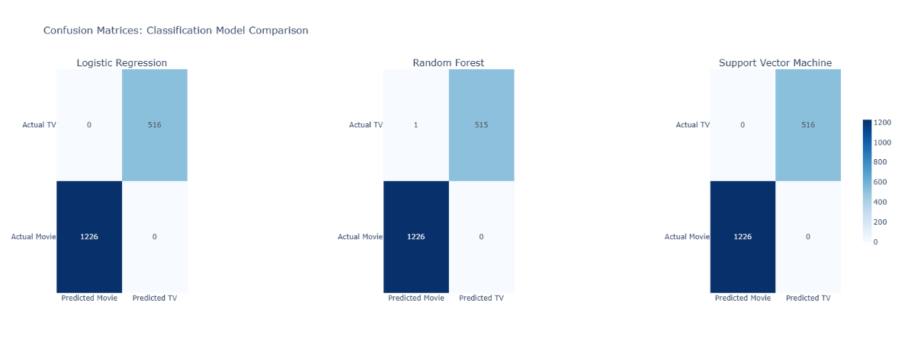
Result
Random Forest:
Achieves perfect classification with zero misclassifications.
Correctly predicts all TV shows and movies, indicating strong linear separability of the data.
Logistic Regression:
Performs almost perfectly, with only one misclassification observed.
Demonstrates high robustness but slightly less precision compared to the other models.
Gradient Boosting:
Also achieves perfect classification with no errors.
Effectively separates the classes, suggesting optimal margin-based decision boundaries.

Slide 18
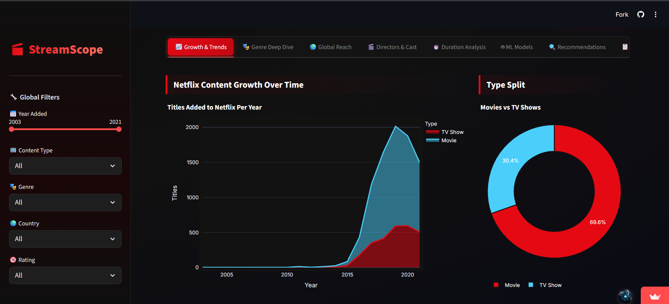
User Interface
Built using Streamlit dashboard
Interactive filters: Year, Genre, Country, Rating
Includes charts, maps, and data explorer
👉 Key Point: User-friendly and interactive system

Slide 19
Challenges
Missing values in dataset (director, cast, country)
Data imbalance between movies and TV shows
Feature selection and model tuning
Handling categorical data
👉 Key Point: Real-world data problems handled

Slide 20
Future Scope
Use real-time Netflix data
Improve recommendation system using AI
Deploy on cloud platform
Add more advanced ML models
👉 Key Point: Can be expanded further

Slide 21
Conclusion
Netflix focuses on global and diverse content
Drama and international genres dominate
Machine learning improves prediction accuracy
Dashboard helps in understanding insights easily
“This project demonstrates how data analytics and machine learning can be used to understand Netflix’s content strategy effectively.”

